Slide 1
Questions?
Group 841

Slide 2
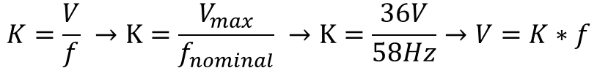
Open loop control – V/f
Open loop control useful for debugging and verifying.
V/F relates voltage and frequency through a constant.
$$K=\frac{V}{f} →K=\frac{V_{max}}{f_{nominal}} →K=\frac{36V}{58Hz}→V=K∗f$$
Duty cycle will be then limited according to V.
At 0Hz, duty cycle is always d = 0. At $f_{nominal}$, the max duty cycle is d = 1.

Slide 3
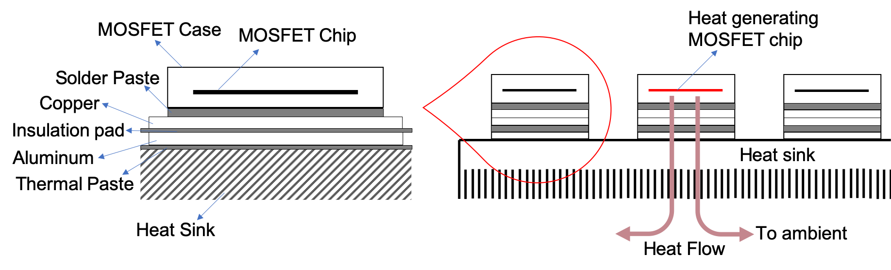
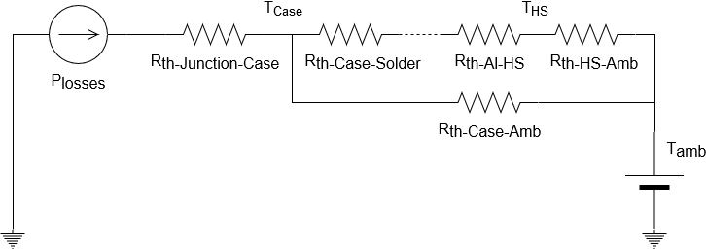



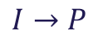
Thermal losses in MOSFETs
Modelled like an electrical circuit where:
$$I→P$$
$$V→T$$
$$R→R_{th}$$
$$∆T=P·R_{th}$$

Slide 4
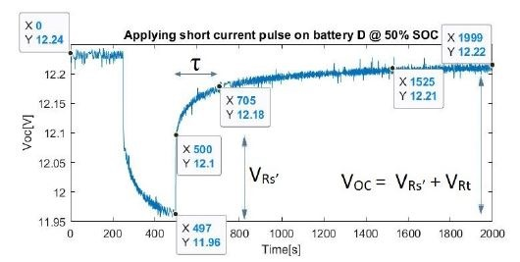
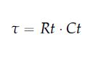
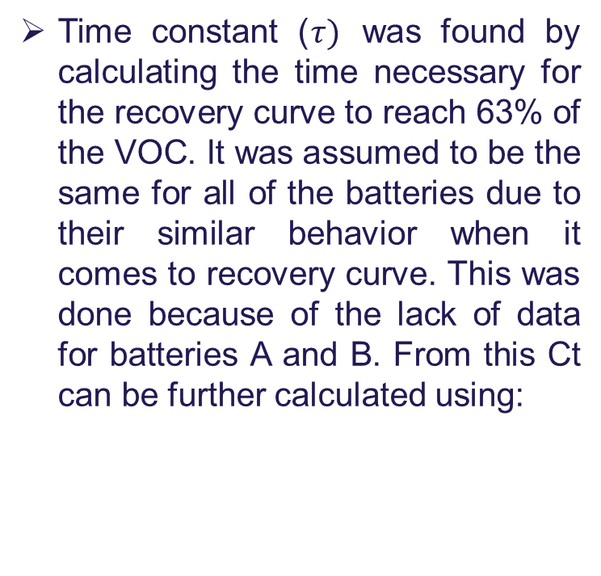
Obtaining the battery parameters
Time constant ($τ)$ was found by calculating the time necessary for the recovery curve to reach 63% of the VOC. It was assumed to be the same for all of the batteries due to their similar behavior when it comes to recovery curve. This was done because of the lack of data for batteries A and B. From this Ct can be further calculated using:

Slide 5
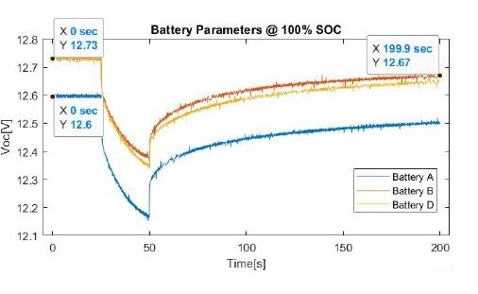
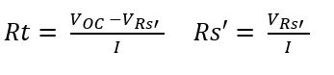
Obtaining the battery parameters
Rs’ an Rt were obtained by substituting the values from the experimental test in the equations:
Where VRs’ and VRt are read from the picture nearby and I is 10A

Slide 6
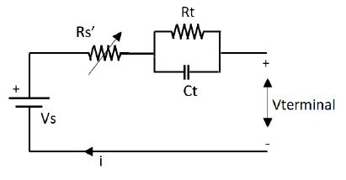
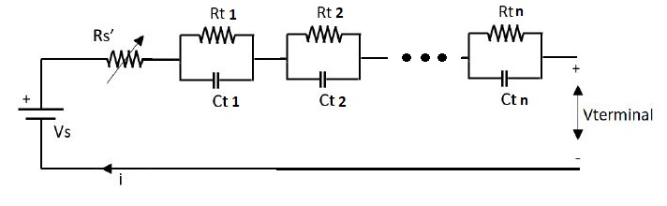
Model the batteries more precise
A bigger number of RC parallel blocks in the model of the batteries will increase the accuracy of the model. This is because approximating the model with only one block it is a correct approach but as it can be seen in the simulation result there is a mismatch in the portion representing charging a capacitor which suggests that the battery has actually more time constants of different values.

Slide 7
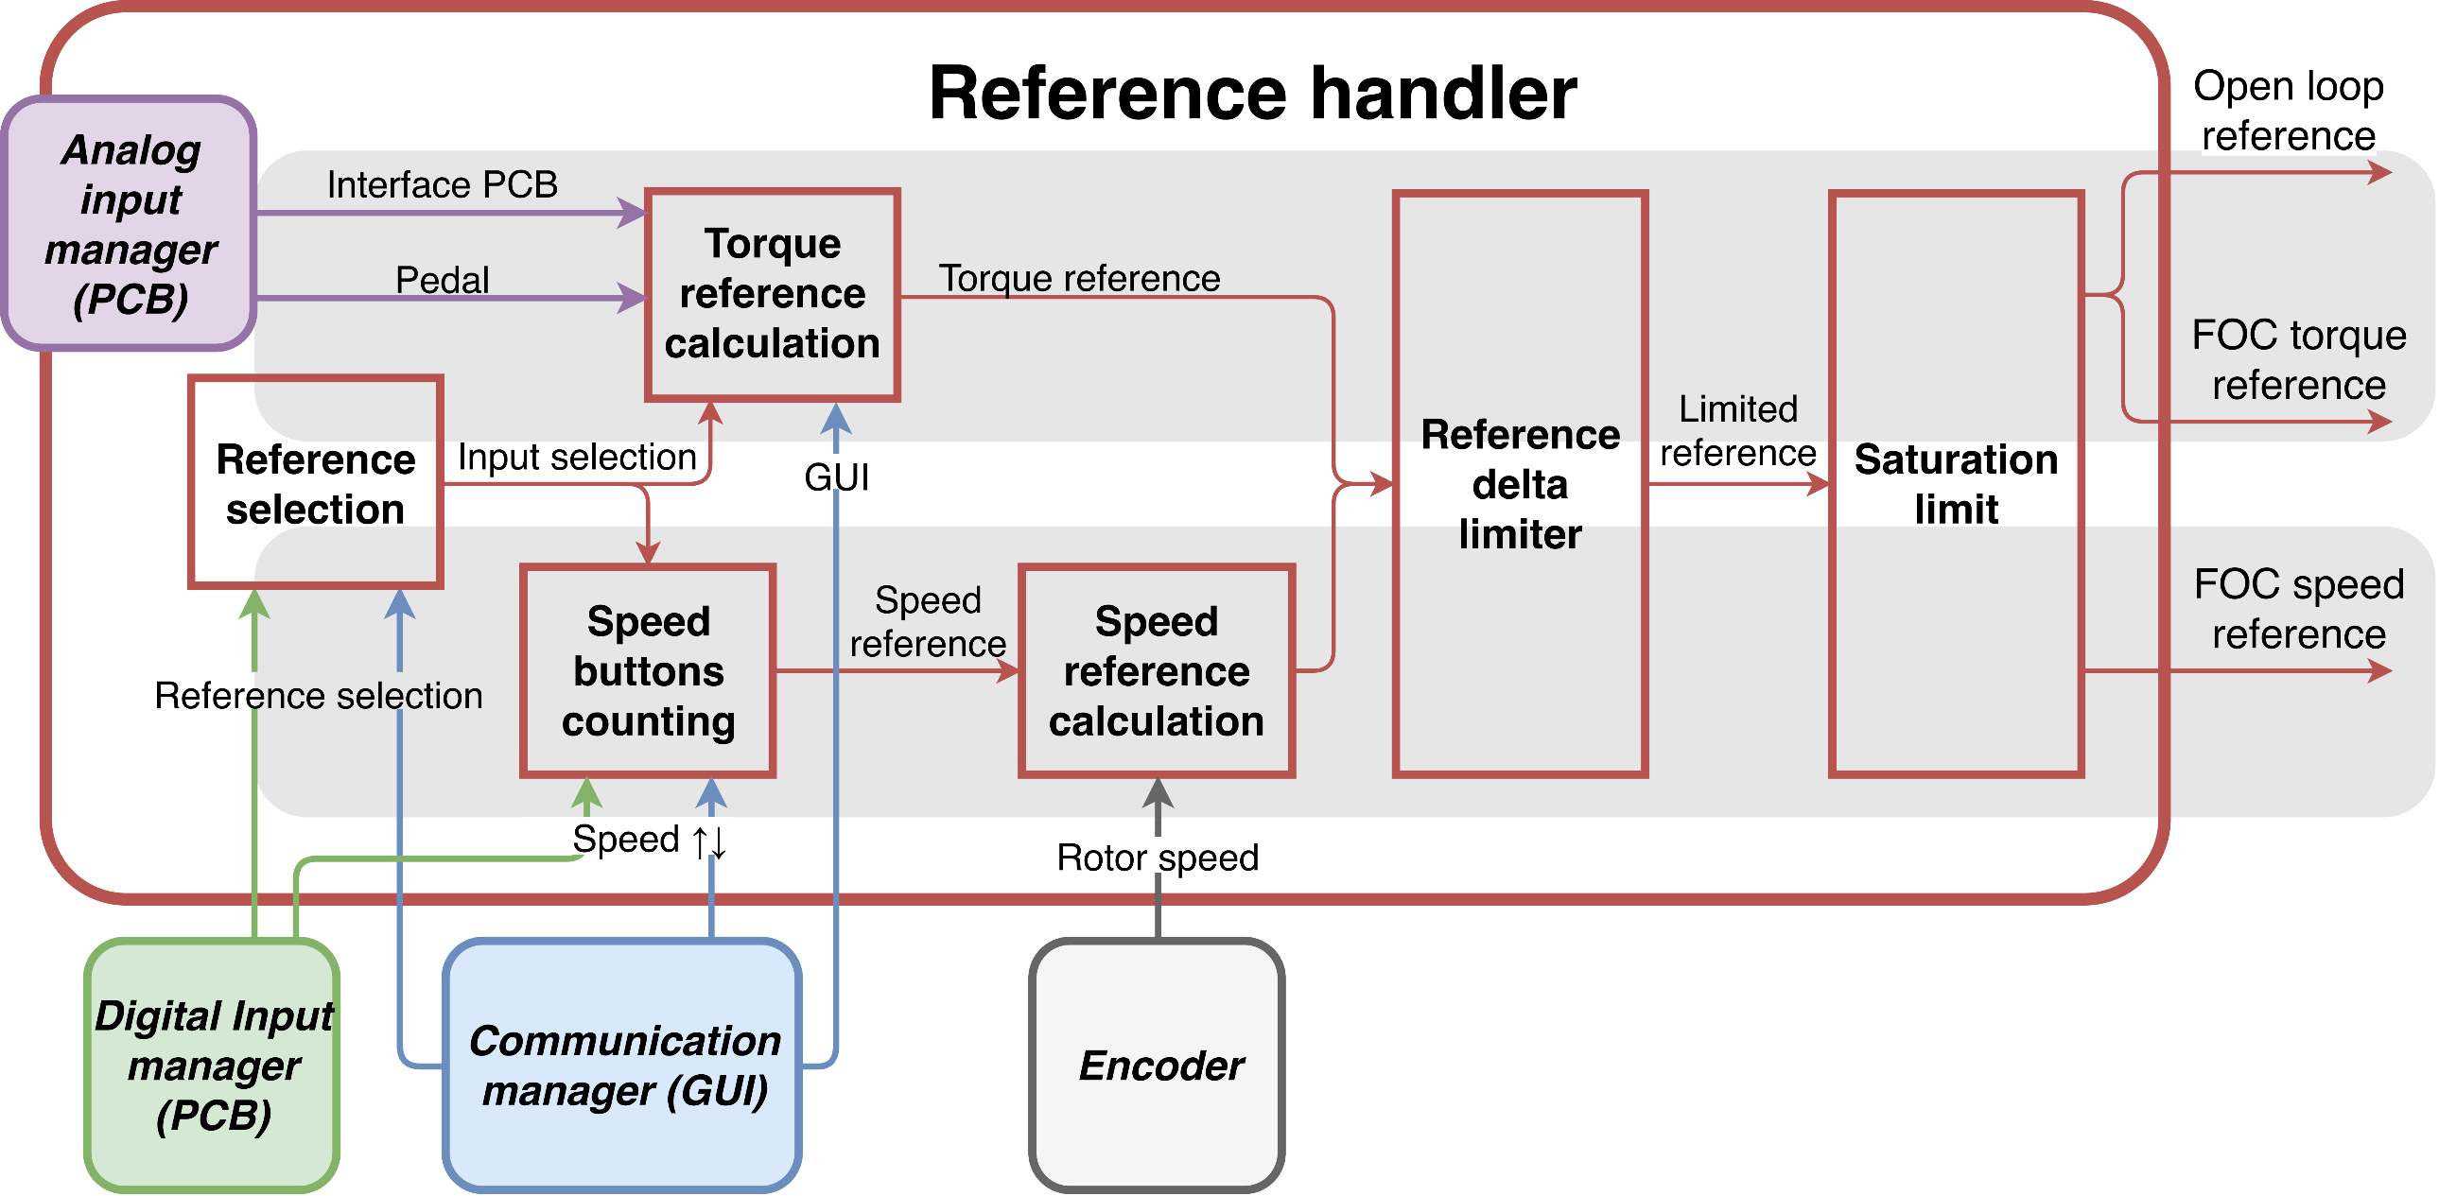
Reference Handler
Features
Reference source selection
Pedal
GUI
Interface PCB
Reference type selection
Torque control
Cruise control
Reference ramp limitation
Reference saturation
Used by motor controller
Complex module which collects information from many other modules

Slide 8
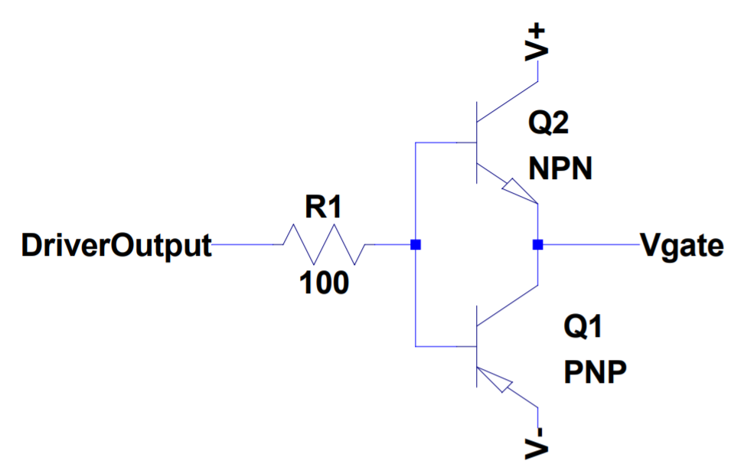
Driver IC damage
Problem
The driver IC was damaged during V/f control when the DC link voltage was increased
Approach
Simulate the circuit with LTSpice
Voltage spikes beyond absolut maximum ratings were found in the driver output
The solution consisted on an increase of the base of the push-pull stage resistor (1 Ohm to 100 Ohm)
Voltage spikes disappeared
Consequences
The rise time (10% to 90%) of Vds increased from 22 ns to 23 ns in simulation, which is acceptable

Slide 9
Regenerative braking implementation
First approach
Software
System requirements definition: Define user experience. Is an electronic braking control necessary(talking about frictional braking)?
Develop a regenerative braking software module. This module will monitor whether the resulting current from the regenerative braking torque command is feasible or it will be beyond battery capabilities. If that is the case, frictional braking must be used.
The rest of the modules already consider negative references and directions.
Hardware
If necessary, mount a brake pedal sensor and actuator to electronically control the frictional brake.

Slide 10
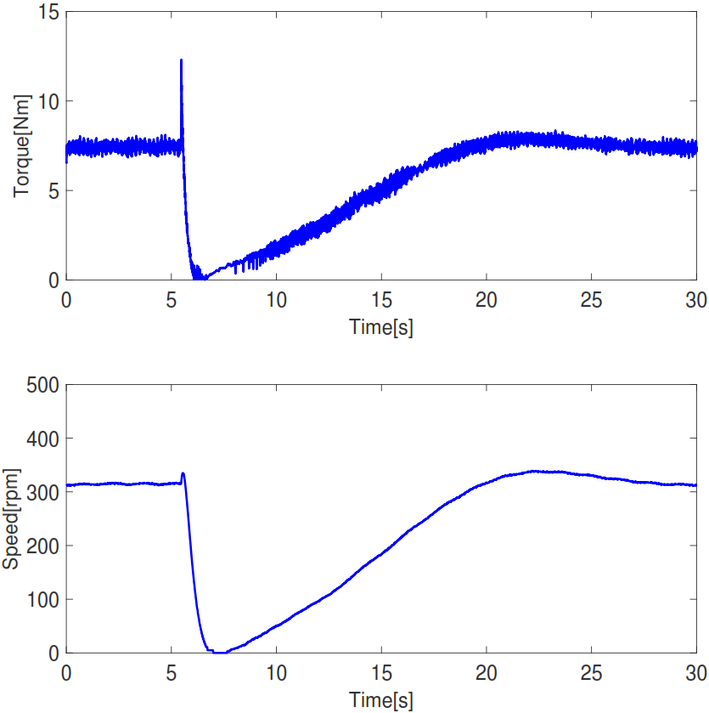
Torque control to Cruise control
Initially, the error is 0 rpm, which is translated into a 0 Nm torque reference
This leads to a decrease in rotor speed (see picture)
In the simulations this behaviour did not appear because the inertia of the system is larger and the PI is more agressive
A solution could be to initialize the speed PI output to the torque reference at the switch instant

Slide 11
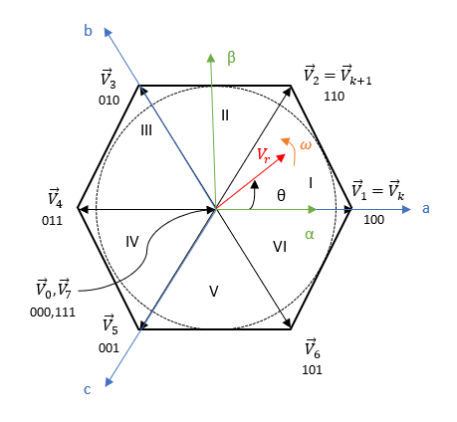
SVM Implementation
Algorithm provided by course Control of Electrical Machines.
Procedure
Limit voltage references (So they are within the ranges which Vdc can provide)
Find sector. Graphical explanation with picture
Calculate dwell times, using logic explained in report
Set duty cycle

Slide 12
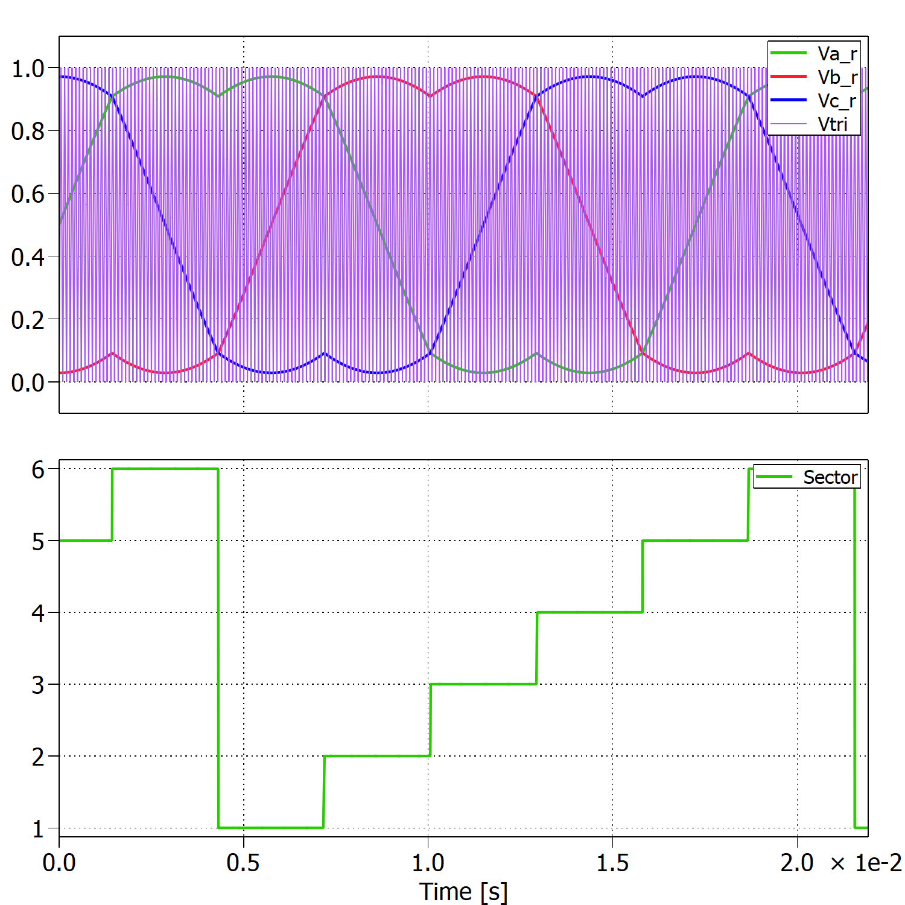
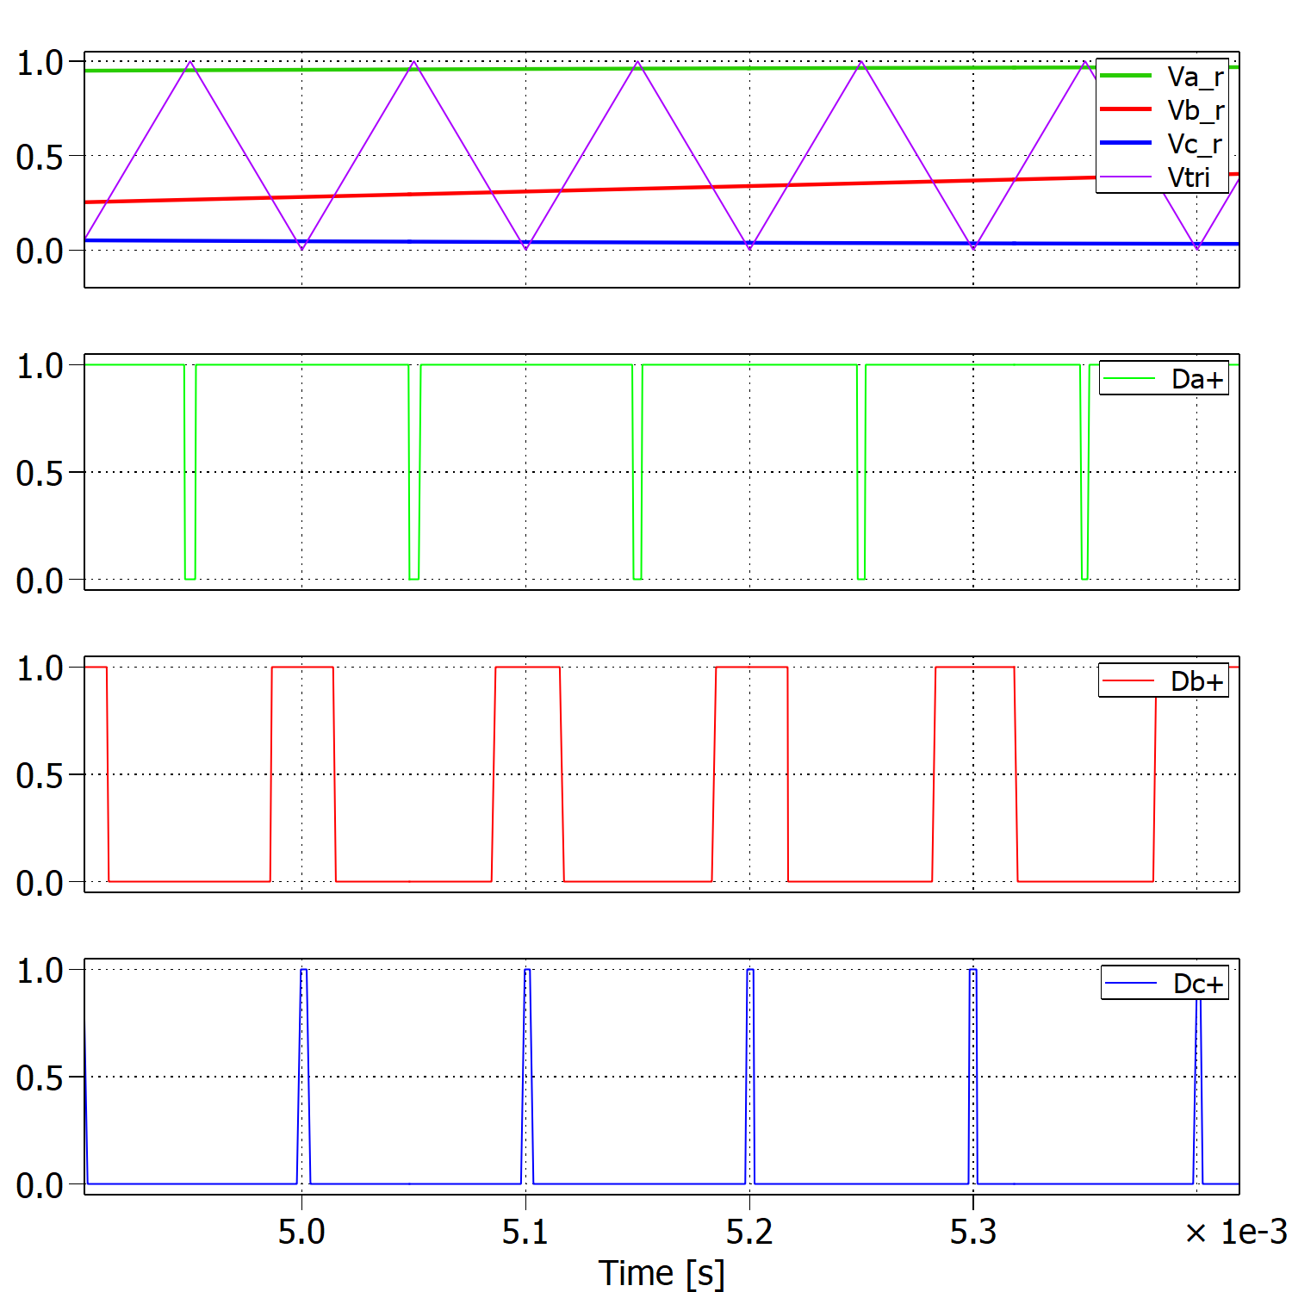
Space Vector Modulation PWM

Slide 13
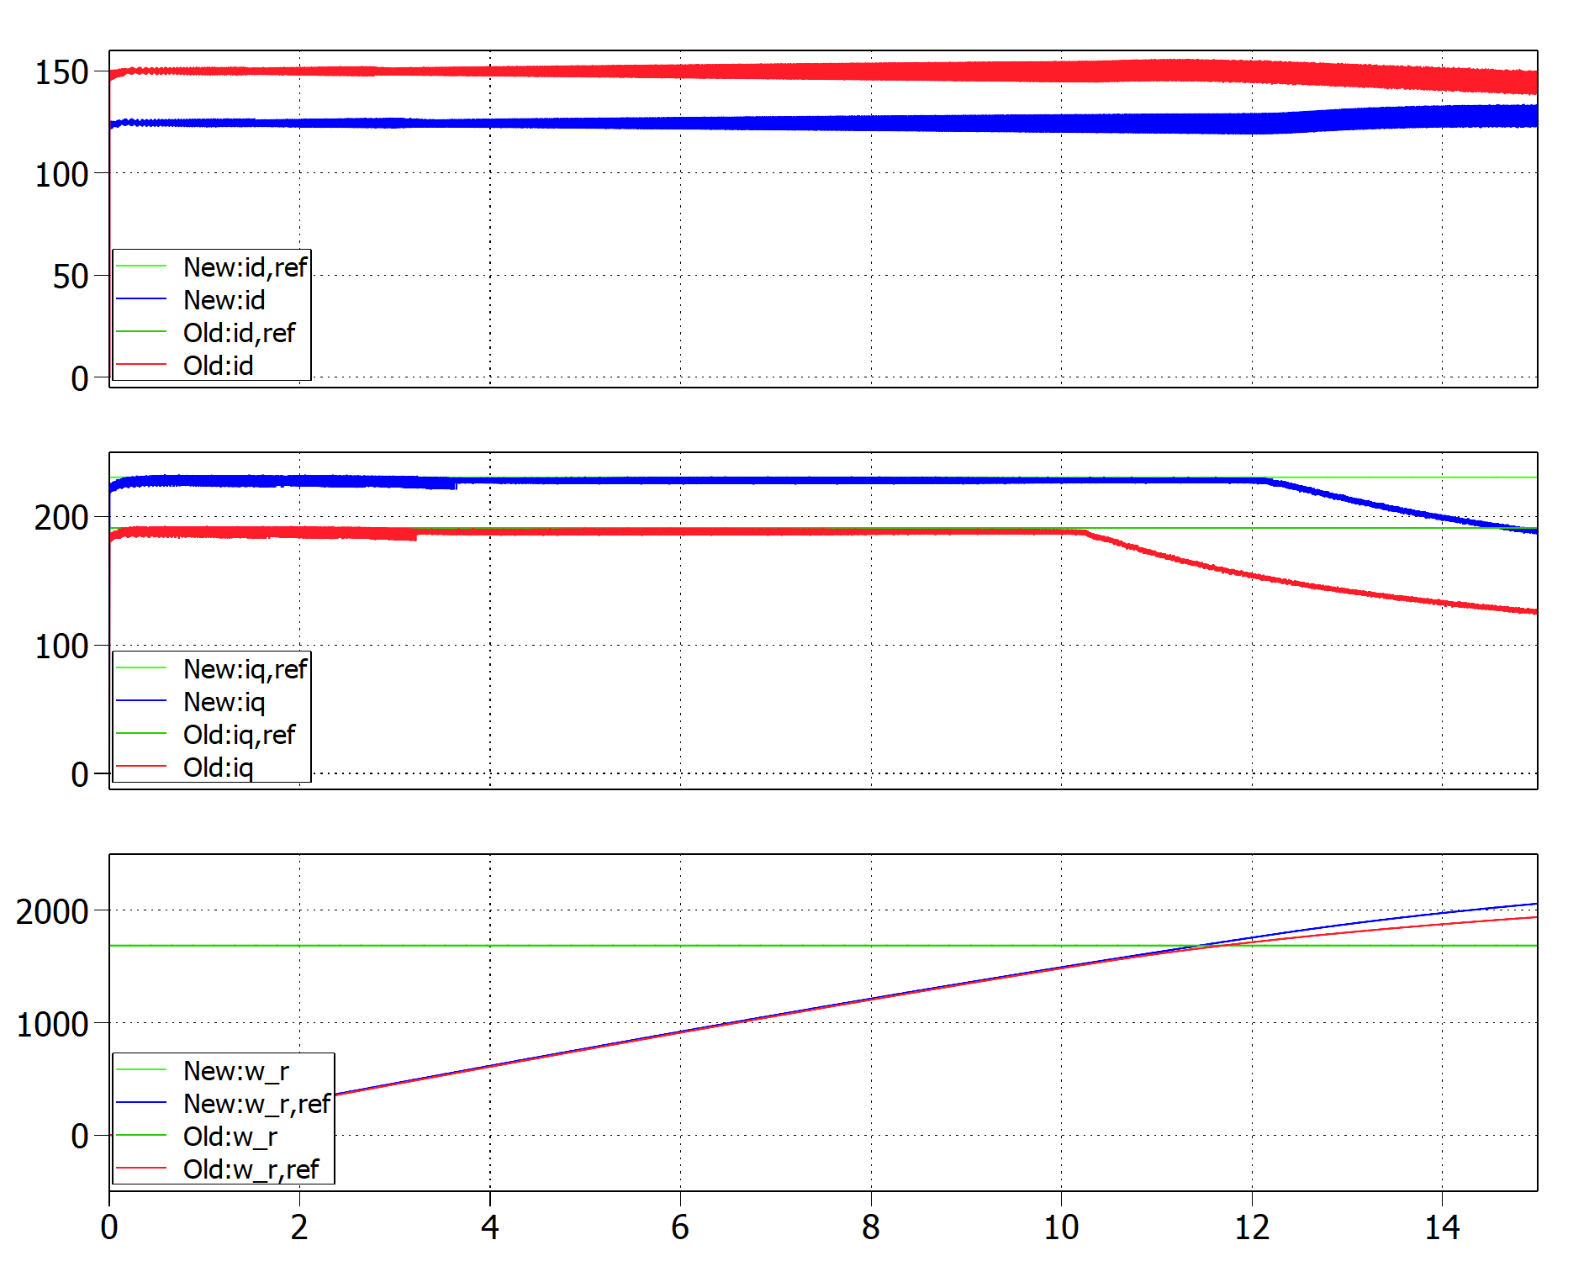
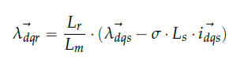
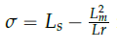


Calculation d-axis current reference
Wrong value of ids,ref:
$$i_{ds,ref}=149.22 A$$
Correct value of ids,ref:
$$i_{ds,ref}=123.5 A$$
1750 rpm
1520 rpm

Slide 14
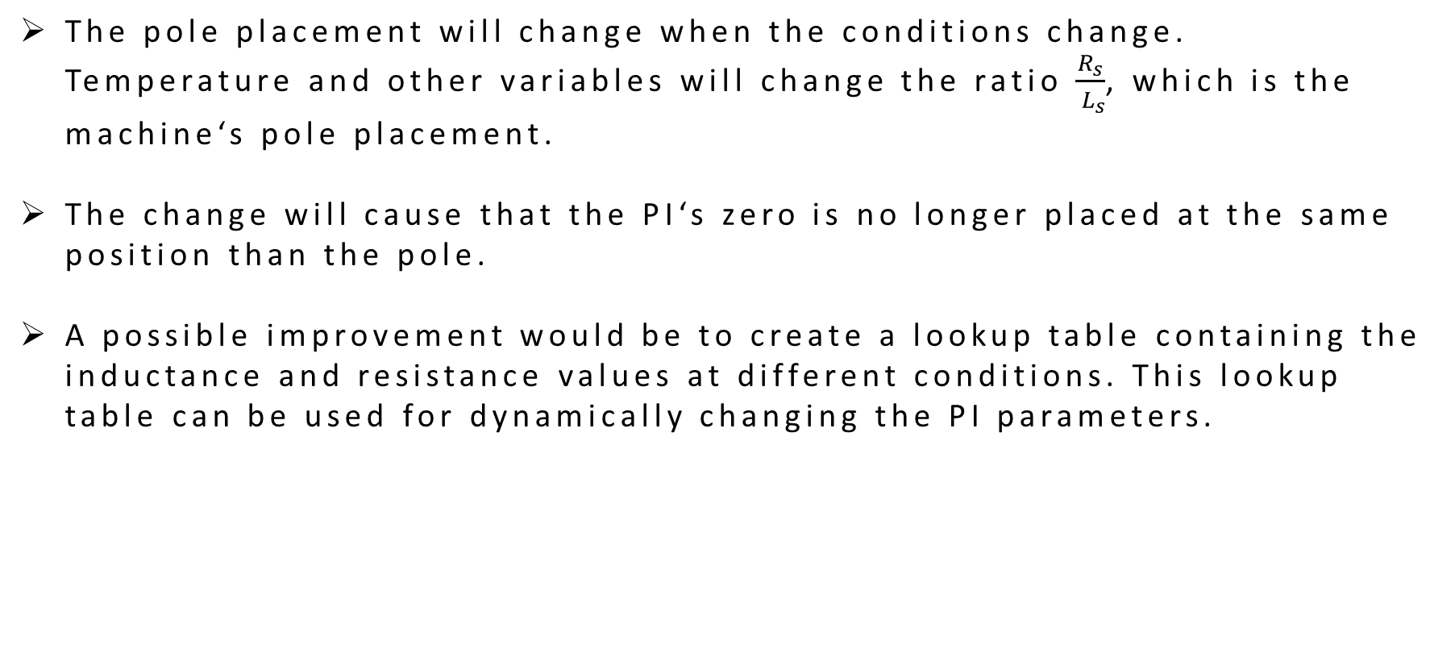
Pole cancellation technique Limitations
The pole placement will change when the conditions change. Temperature and other variables will change the ratio $\frac{R_{s}}{{ L}_{s}}$, which is the machine‘s pole placement.
The change will cause that the PI‘s zero is no longer placed at the same position than the pole.
A possible improvement would be to create a lookup table containing the inductance and resistance values at different conditions. This lookup table can be used for dynamically changing the PI parameters.

Slide 15
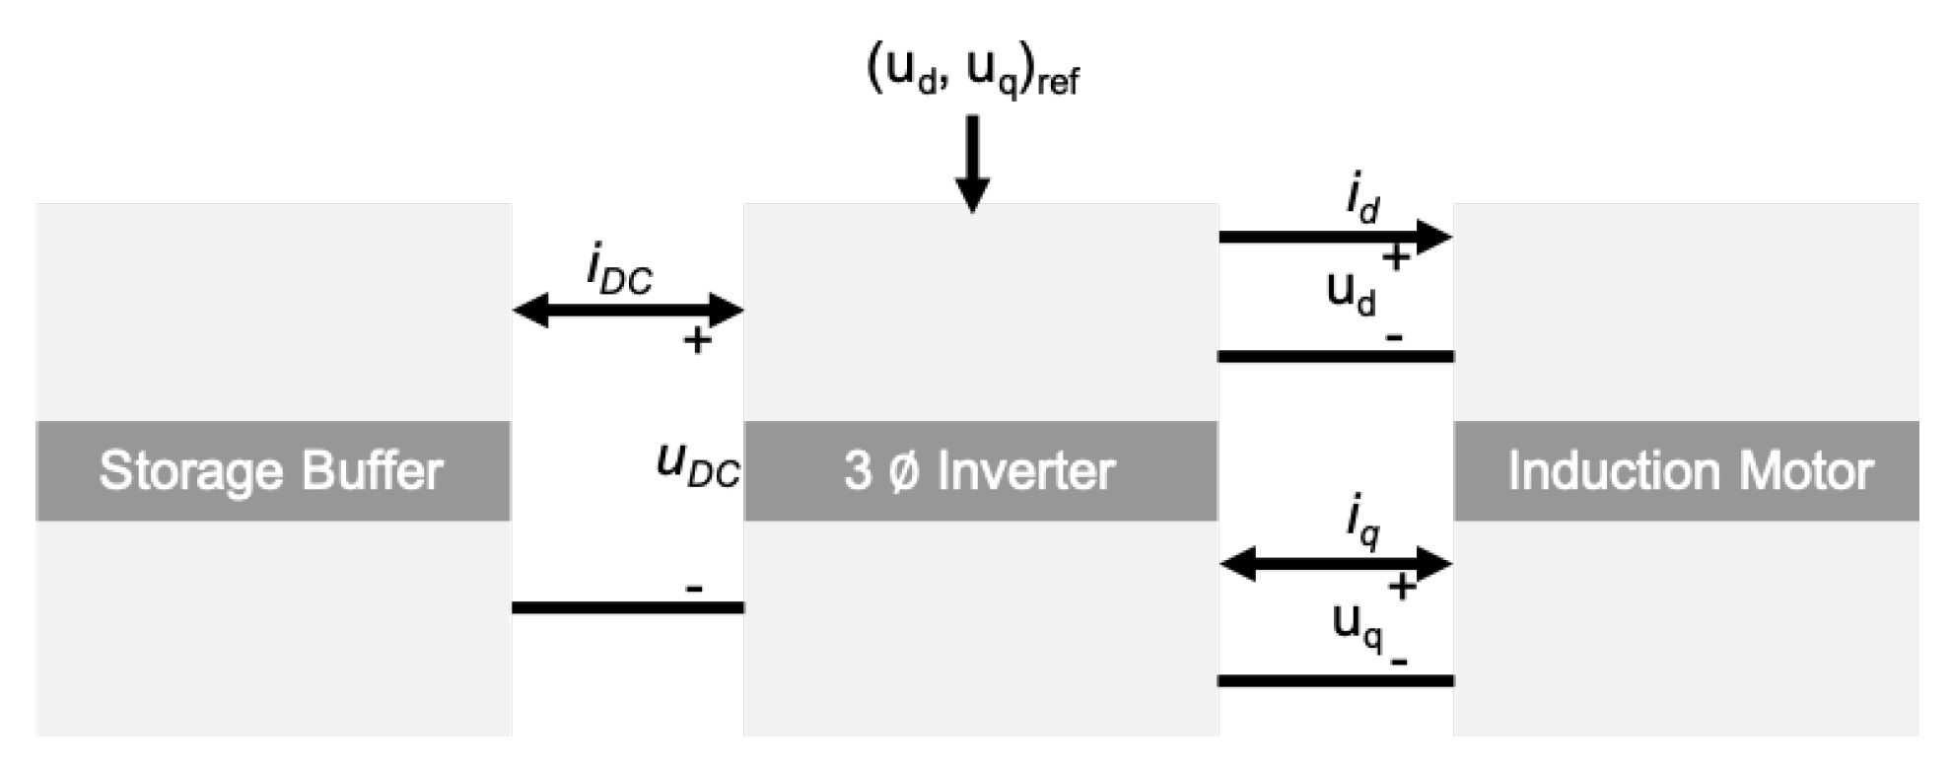
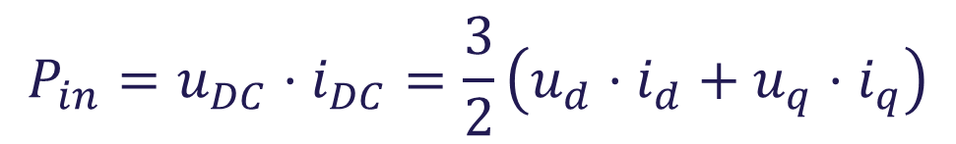
Power flow in regenerative braking
$$P_{in}=u_{DC}⋅i_{DC}=\frac{3}{2}\left(u_{d}⋅i_{d}+u_{q}⋅i_{q}\right)$$

Slide 16
Power flow in regenerative braking
For the power to flow back to the DC-link the power has to become negative
For this to happen the q-part has to make the expression negative
When a negative torque reference is given, then the q-current will turn negative as well
As the d-current is positive, then the d-voltage has to drop, for that part to become smaller

Slide 17
Integral anti-windup
Limit the output of the PI controllers with saturation blocks
A saturated output would lead to a big error term, as the PI is not allowed to follow the reference
Causes oscillations on the system response
This is solved by using anti-windup

Slide 18
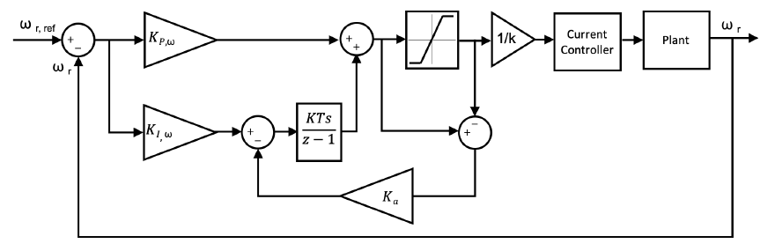
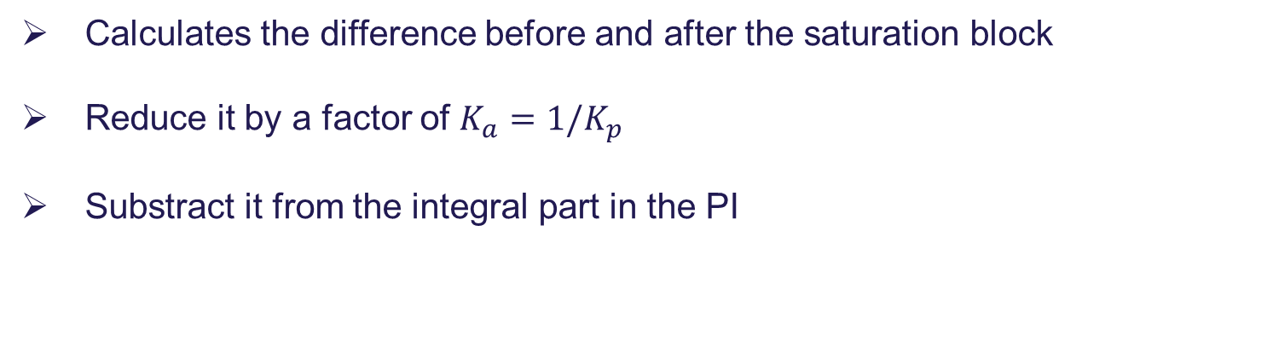
Integral anti-windup
Calculates the difference before and after the saturation block
Reduce it by a factor of $K_{a}=1/K_{p}$
Substract it from the integral part in the PI

Slide 19
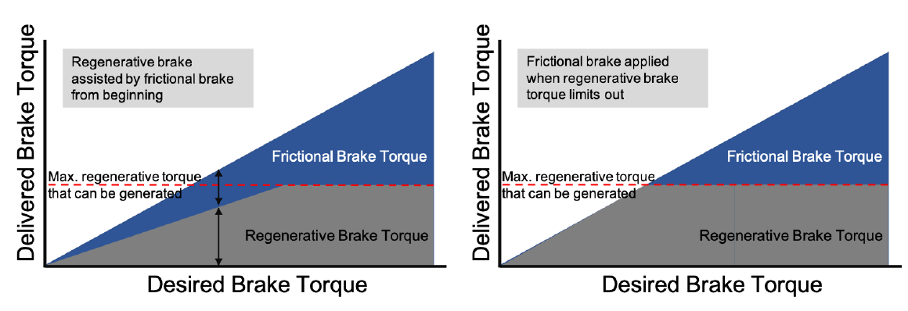
Serial and parallel regenerative braking
In parallel regenerative braking (left), the braking torque is divided between frictional and regeneration, in the entire braking scope
In series regenerative braking (right), first the full regenerative torque is applied, before frictional braking is used

Slide 20
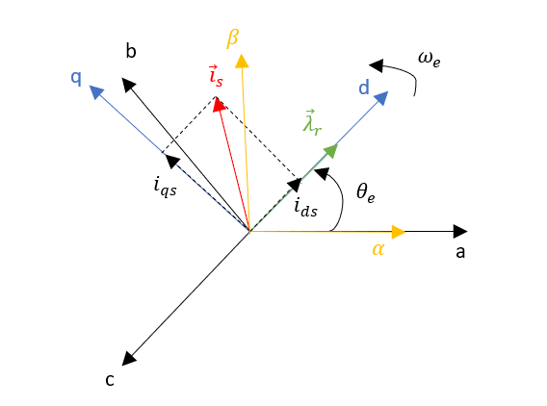
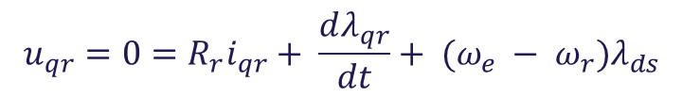
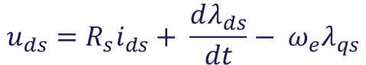
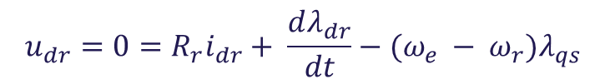
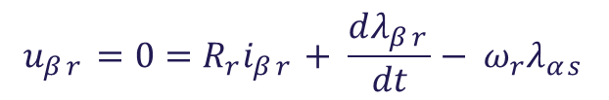
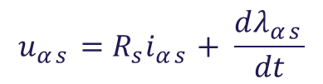

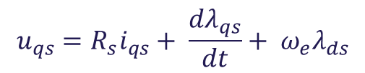
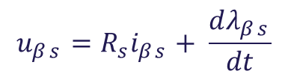
Induction machine equations
Voltage equations dq reference frame:
$$u_{ds}=R_{s}i_{ds}+ \frac{dλ_{ds}}{dt}− ω_{e}λ_{qs}$$
$$u_{dr}=0=R_{r}i_{dr}+ \frac{dλ_{dr}}{dt}−(ω_{e} − {ω_{r})λ}_{qs}$$
$$u_{qs}=R_{s}i_{qs}+ \frac{dλ_{qs}}{dt}+ ω_{e}λ_{ds}$$
$$u_{qr}=0=R_{r}i_{qr}+ \frac{dλ_{qr}}{dt}+ (ω_{e} − {ω_{r})λ}_{ds}$$
Voltage equations $αβ$ reference frame: $ω_{e}=0$
$$u_{αs}=R_{s}i_{αs}+ \frac{dλ_{αs}}{dt}$$
$$u_{αr}=0=R_{r}i_{αr}+ \frac{dλ_{αr}}{dt}+{ω_{r}λ}_{βs}$$
$$u_{βs}=R_{s}i_{βs}+ \frac{dλ_{βs}}{dt}$$
$$u_{βr}=0=R_{r}i_{βr}+ \frac{dλ_{βr}}{dt}− {ω_{r}λ}_{αs}$$

Slide 21
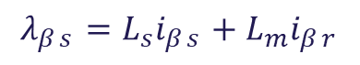








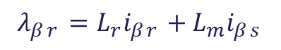
Induction machine equations
Flux linkage equations dq reference frame:
$$λ_{ds}=L_{s}i_{ds}+L_{m}i_{dr}$$
$$λ_{dr}=L_{r}i_{dr}+L_{m}i_{ds}$$
$$L_{r}=L_{lr}+ L_{m}$$
$$λ_{qr}=L_{r}i_{qr}+L_{m}i_{qs}$$
$$L_{s}=L_{ls}+ L_{m}$$
$$λ_{qs}=L_{s}i_{qs}+L_{m}i_{dr}$$
Flux linkage equations $αβ$ reference frame:
$$λ_{αs}=L_{s}i_{αs}+L_{m}i_{αr}$$
$$λ_{αr}=L_{r}i_{αr}+L_{m}i_{αs}$$
$$λ_{βs}=L_{s}i_{βs}+L_{m}i_{βr}$$
$$λ_{βr}=L_{r}i_{βr}+L_{m}i_{βs}$$

Slide 22
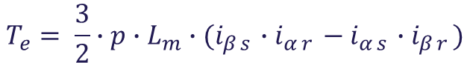
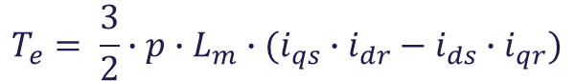
Induction machine equations
Torque equation dq reference frame:
$$T_{e}= \frac{3}{2}∙p∙L_{m}∙(i_{qs}{∙i}_{dr}− i_{ds}∙i_{qr})$$
Torque equation $αβ$ reference frame:
$$T_{e}= \frac{3}{2}∙p∙L_{m}∙(i_{βs}{∙i}_{αr}− i_{αs}∙i_{βr})$$

Slide 23
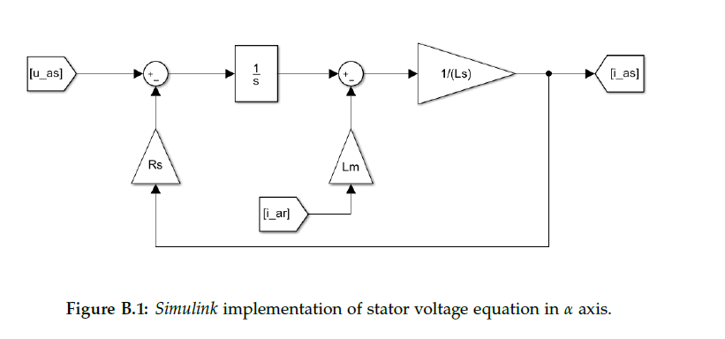
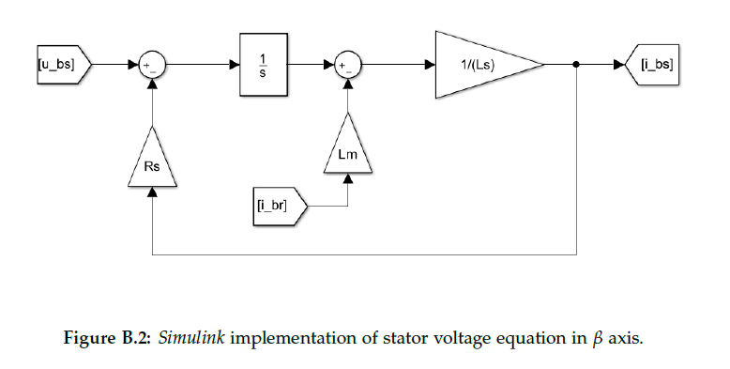
Induction machine model

Slide 24
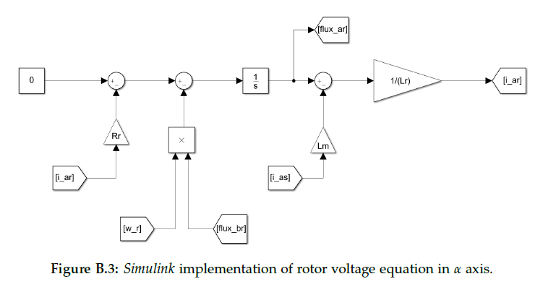
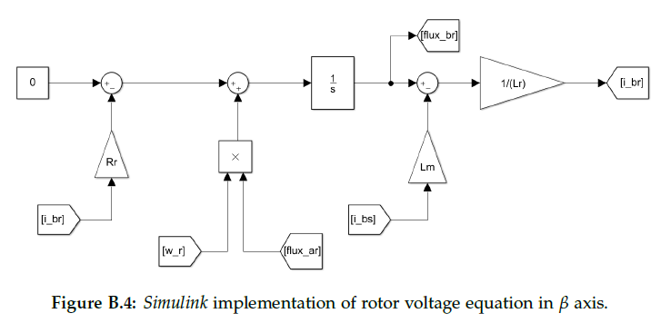
Induction machine model

Slide 25
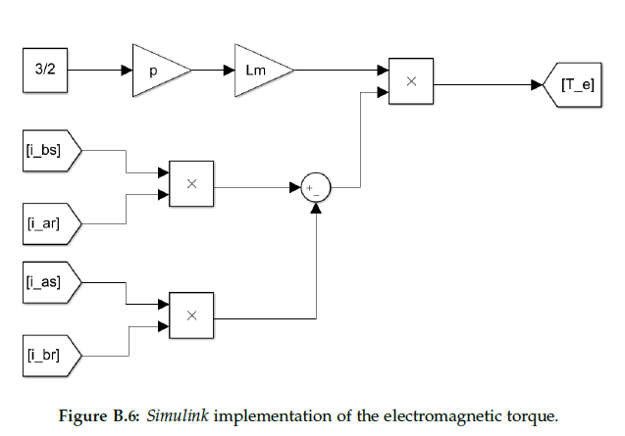
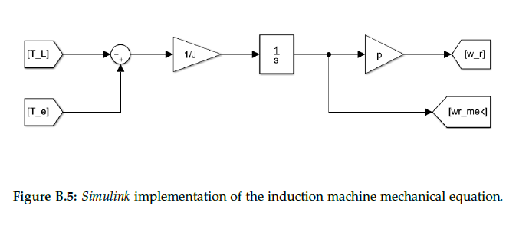
Induction machine model

Slide 26
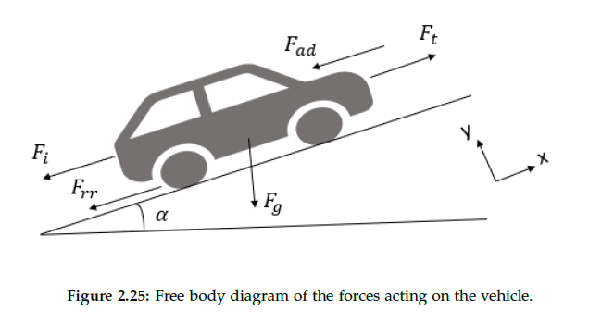
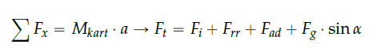
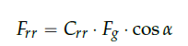
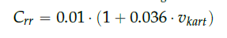
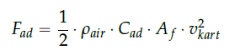
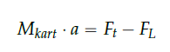


Go-kart mechanical model
Maximum linear
acceleration

Slide 27

Parallel MOSFET
$$P_{motor}=7300W$$
Using the motor power factor and efficiency we can calculate total apparent power
$S_{motor}= \frac{P_{mtor}}{{PF}_{motor} ∗ η_{motor}}=10915 VA$
For a balanced 3-phase system
$$S_{motor}= \sqrt{3}∗V_{line}∗I_{line}$$
For a star connected load
$$S_{motor}= \sqrt{3}∗V_{line}∗I_{phase} \\ I_{phase}=263A_{rms}=371A_{pk}$$
1
3
5
V_{A}
DC Link
V_{B}
V_{C}
4
6
2
Drain
R_{gate}
R_{gate}
Driver
Source

Slide 28

Parallel MOSFET
By comparing multiple available MOSFETs from different manufactures of rating 60V and 80V for 300A.
Based on the obtained SPICE model simulation IPT007N06N and IPT012N08N5 are the most suitable MOSFETS. But, due to IPT012N08N5 higher drain-source voltage of 80V, it can ensure a better safety margin that occurs in turn off transition of the MOSFETs.

Slide 29

MOSFET loss calculation
MOSFET loss can be modelled in parts
$$P_{MOSFET}=P_{con}+P_{sw}+P_{gate}=30.3W$$
Conduction losses
$P_{con}={\left(\frac{I_{rms}}{n_{parallel} }\right)}^{2}{RDS}_{on}=24.2W$
Switching losses
$$E_{on}={(V}_{DC}∗\frac{I_{pk}}{n_{parallel} }∗t_{on}+Q_{rr}∗V_{DC})+(\frac{1}{4}Q_{rr}∗V_{DC})$$ $E_{off}=V_{DC}∗\frac{I_{pk}}{n_{parallel} }∗t_{off}$
$$P_{sw}= {(E}_{on}+E_{off})∗f_{sw}=5.9W$$
Gate loss
$$P_{Qg}= Q_{g}∗\left(V_{dr.on}−V_{dr.off}\right)$$
$$P_{Rg}= P_{Qg} \\ P_{gate}=\left(P_{Qg}+P_{Rg}\right)∗f_{sw}=0.211W$$
Operating Condition
 | Values | Unit
DC link voltage (V_{DC}) | 36 | V
Power Rating | 7.3 | kW
RMS current (I_{RMS}) | 263 | A
Peak current (I_{pk}) | 371 | A
Switching Frequency (f_{sw}) | 20 | kHz
MOSFET Parameter (IPT012N08N5)
 | Values | Unit
DS voltage (V_{DS}) | 80 | V
R_{DS(on),max} | 1.2 | mΩ
Drain current (I_{D}) | 300 | A
Output Capacitance (Q_{oss}) | 208 | nC
Gate Capacitance (Q_{G}) | 178 | nC

Slide 30
Discretization of controller
After designing the controller in continuous domain it is converter into discrete domain because the DSP will work in discrete.
The delay introduced by the DSP is already considered in continuous design.
The plant transfer function will be discretized using ZOH as this is how the signals will be provided to the real system
The integral action in PI controllers will be discretized by Forward Euler method.

